Slide 1
Design Patterns
Elements of Reusable Code
Programming – Code Design and Data Structures
Last modified 09/02/16 by Sam Cartwright

Slide 2

Contents
What are Design Patterns
Types of Design Patterns
Common Patterns in Games
Singleton
Pooling
Factory
Prototype

Slide 3
Designing Software is Hard
Designing good software is hard
Designing reusable object-oriented software is even harder
Don’t solve every problem from first principles
You will find recurring patters of classes in many object-oriented systems
Notes:
Designing reusable object oriented software is difficult.
As programmers, we must find the objects that exist within our problem scope, factor them into classes at the right granularity (an inheritance hierarchy that is too deep will overly complicate our code, but one too shallow won’t be flexible enough), and we must establish key relationships among them.
We need to make a design that is both specific to the problem at hand yet also general enough to address future problems and requirements – especially if we are designing something to be reusable.
New programmers often tend to fall back on non-object-oriented techniques that they’ve used before. Good objet-oriented design skills take time.
One thing that expert designers don’t do is try to solve every problem from first principles. Rather, they reuse solutions that have worked for them in the past.
When they find a good solution, they reuse it again and again.
These patterns solve specific design problems and make object-oriented design more flexible, elegant, and reusable. As programmers, they help us by allowing us to draw on successful designs that have been proven to work well in a variety of similar situations. This means we can create better programs by allying good design patterns immediately to our problems instead of trying to rediscover them ourselves.

Slide 4



Hollywood Analogy
Tragically Flawed Hero
The Romantic Novel
Overcoming Evil
Once you know the pattern, a lot of design decisions follow automatically
Notes:
Novelists and playwrights rarely design their plots from scratch.
Instead, they follow patterns like “Tragically Flawed Hero” or “The Romantic Novel”.
In the same way, object-oriented designers follow patterns like “represent states with objects” and “decorate objects so you can easily add/remove features”
Once you know the pattern, a lot of design decisions follow automatically

Slide 5
Types
Design Patterns: Elements of Reusable Object-Oriented Software is a well known programming book on this topic
The authors are sometimes referred to as The Gang of Four
The Gang of Four listed 3 groups of design patterns
Creational
Concern the process of object creation
Structural
Deal with the composition of classes or objects
Behavioural
Characterize the way in which classes or objects interact and distribute responsibility
Notes:
‘Gang of Four’ refers to the 4 authors of the seminal text ‘Design Patterns: Elements of Reusable Object-Oriented Software’
Erich Gamma, Richard Helm, Ralph Johnson, and John Vlissides
This book is over 2 decade now, and quite tough to get through, but does have loads of good advice on designing reusable software.
The list of all patterns is shown to make students aware that this is a big topic, and there are many more patterns that they will find useful when making their programs.
Students should be encouraged to read both references (but probably the Game Programming Patterns first)

Slide 6
Design Patterns
Creational | Structural | Behavioural
Factory Builder Prototype Singleton | Adapter Bridge Composite Decorator Façade Flyweight Proxy | Chain of Responsibility Command Iterator Mediator Memento Observer (Publisher-Subscriber) State Strategy Visitor
Notes:
We only cover the ones in bold
(these patterns are also explained in the Game Programming Patterns text – also available online)

Slide 7
Game Programming Patterns
Game Programming Patterns, written by Robert Nystrom, adapts and extends the types for games:
Sequencing | Behavioural | Decoupling | Optimizing
Double Buffer Game Loop Update Method | Bytecode Subclass Sandbox Type Object | Component Event Queue Service Locator | Data Locality Dirty Flag Object Pool Spatial Partition

Slide 8
Singleton
Global variables are bad
Accidentally corrupted
Needs extern in every file with access
Accidentally make duplicate global variables
Singleton overcomes these problems
Ensures a class only has one instance
Provides a global point of access to it

Slide 9
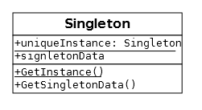
Singleton: Structure
The unique instance stored as a static member
Static members variables are like globals, they can be accessed without an instance of the class
But they can be encapsulated and protected
Static member functions used to control instancing and access of the class

Slide 10
Singleton: Applicability
Use the singleton pattern when:
There must be exactly one instance of a class
It must be accessible to clients from a well-known access point
Don’t use the Singleton Pattern because:
It makes it harder to reason about code
It encourages coupling
It isn’t concurrency-friendly
Notes:
They make it harder to reason about code. Say we’re tracking down a bug in a function someone else wrote. If that function doesn’t touch any global state, we can wrap our heads around it just by understanding the body of thefunction and the arguments being passed to it.
Now, imagine right in the middle of that function is a call toSomeClass::getSomeGlobalData(). To figure out what’s going on, we have to hunt through the entire codebase to see what touches that global data. You don’t really hate global state until you’ve had to grep a million lines of code at three in the morning trying to find the one errant call that’s setting a static variable to the wrong value.
They encourage coupling. The new coder on your team isn’t familiar with your game’s beautifully maintainable loosely coupled architecture, but he’s just been given his first task: make boulders play sounds when they crash onto the ground. You and I know we don’t want the physics code to be coupled to audio of all things, but he’s just trying to get his task done. Unfortunately for us, the instance of our AudioPlayer is globally visible. So, one little #include later, and our new guy has compromised a carefully constructed architecture.
Without a global instance of the audio player, even if he did #include the header, he still wouldn’t be able to do anything with it. That difficulty sends a clear message to him that those two modules should not know about each other and that he needs to find another way to solve his problem. By controlling access to instances, you control coupling.
They aren’t concurrency-friendly. The days of games running on a simple single-core CPU are pretty much over. Code today must at the very leastwork in a multi-threaded way even if it doesn’t take full advantage of concurrency. When we make something global, we’ve created a chunk of memory that every thread can see and poke at, whether or not they know what other threads are doing to it. That path leads to deadlocks, race conditions, and other hell-to-fix thread-synchronization bugs.

Slide 11
Singleton: Implementation
class WillFarrell
{
protected:
// Protect the c'tors and d'tors
// Therefore this class is the only
// object that can create itself
WillFarrell(void);
~WillFarrell(void);
// The one and only instance of this class
static WillFarrell* m_instance;
public:
// The function for providing access
static WillFarrell* Instance();
void SaySomething();
};
WillFarrell* WillFarrell::m_instance = nullptr;
WillFarrell::WillFarrell(void)
{
}
WillFarrell::~WillFarrell(void)
{
}
// Function for providing access to the class
WillFarrell* WillFarrell::Instance()
{
// If no instance exists, create one
if(m_instance == nullptr)
{
// (There's only one Will Farrell)
m_instance = new WillFarrell;
}
return m_instance;
}
void WillFarrell::SaySomething()
{
std::cout << "Well, that escalated quickly." << std::endl;
}
(because there’s only one Will Farrell)

Slide 12

Singleton Usage
Access is provided via a function
Any file that includes the singleton header will have access to that class
#include "WillFarrell.h"
int main(int argc, char* argv[])
{
WillFarrell::Instance()->SaySomething();
return 0;
}

Slide 13
Object Pool
Improve memory performance
Reuses objects from a fixed pool instead of creating / destroying objects
Used when:
Need to frequently create / destroy objects
Objects are small in size
Allocating on the heap is slow / could lead to fragmentation
Notes:
http://gameprogrammingpatterns.com/object-pool.html

Slide 14
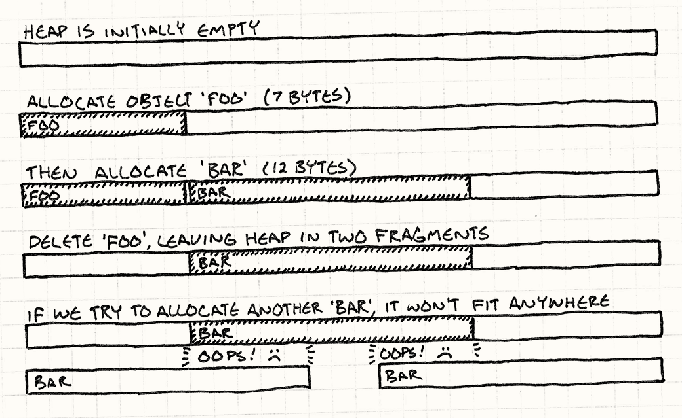
Object Pool
Avoids memory fragmentation
Image source: Game Programming Patterns, http://gameprogrammingpatterns.com/object-pool.html
Notes:
Fragmentation means the free space in our heap is broken into smaller pieces of memory instead of one large open block. The total memory available may be large, but the largest contiguous region might be painfully small. Say we’ve got fourteen bytes free, but it’s fragmented into two seven-byte pieces with a chunk of in-use memory between them. If we try to allocate a twelve-byte object, we’ll fail. No more sparklies on screen.

Slide 15
Object Pool
Define a pool, a collection of reusable objects
Each object tracks it’s alive state
On launch create all objects, set state to dead
To spawn a new object get the first dead one, set to alive
When no longer needed, set to dead and return to the list

Slide 16

Factory
A Factory is used to construct objects without having to specify the exact type
The type can be specified with an identifier
Such as a string, or integer
There are many methods of implementing this
Most games have some form of factory

Slide 17
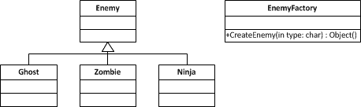
Factory: Implementation
The factory creates an object that is specified by a string
The function could be setup like this:
Enemy* EnemyFactory::CreateEnemy(const char* typeName) {
if ( strcmp(typeName, “Ghost") == 0 )
return new Ghost();
if ( strcmp(typeName, “Zombie") == 0 )
return new Zombie();
if ( strcmp(typeName, “Ninja") == 0 )
return new Ninja();
//Oh no! Unknown type
std::cout << "Unknown type: " << typeName << std::endl;
return nullptr;
}

Slide 18
Why use Factories?
Easy creation of new types at run time
All creation code is in one place
Objects could be reused
Keep track of free and used objects to avoid new’ing memory
Makes saving / loading games easier

Slide 19
Factories are Awesome
Level files could contain object names and values
The level can use the factory to make objects of the given type
The object themselves can have their own Load / Save functions (serialise / deserialise)
So as they are constructed they are handed the file containing their data
<?xml version="1.0" encoding="utf-8"?>
<level>
<Object>
<Name>Zombie</Name>
<Properties> <Position x="5" y="2"/>
<Size x="64" y="48"/>
<Rotation>0</Rotation>
</Properties>
</Object>
</level>

Slide 20
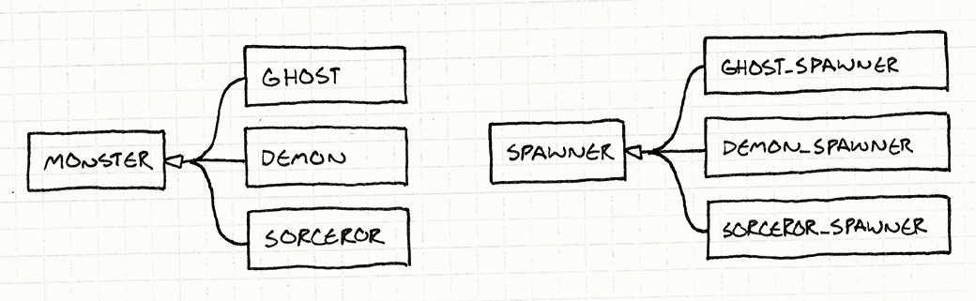
Prototype
Problem:
We have 3 types of monsters in our game
We want to spawn these monsters in our game…
So we create 3 types of spawners
This makes an awful lot of repeated code
Image source: Game Programming Patterns, http://gameprogrammingpatterns.com/prototype.html

Slide 21
Prototype
The key idea with this pattern is:
Any object can spawn other objects similar to itself
If you have a ghost, can use it to create more ghosts
Any monster can be treated as a prototypal monster to generate other versions of itself

Slide 22
Prototype: Implementation
class Monster
{
public:
virtual ~Monster() {}
virtual Monster* clone() = 0;
// Other stuff...
};
Add an abstract clone function to the base class
Each monster returns an object identical to itself
class Ghost : public Monster {
public:
Ghost(int health, int speed)
: health_(health),
speed_(speed)
{}
virtual Monster* clone()
{
return new Ghost(health_, speed_);
}
private:
int health_;
int speed_;
};

Slide 23
Prototype: Implementation
We no longer need all the different spawner classes
Instead, make the one spawner class
This class holds a hidden monster, used as a template to spawn more like it
class Spawner
{
public:
Spawner(Monster* prototype)
: prototype_(prototype)
{}
Monster* spawnMonster()
{
return prototype_->clone();
}
private:
Monster* prototype_;
};
Notes:
One neat part about this pattern is that it doesn’t just clone the class of the prototype, it clones its state too. This means we could make a spawner for fast ghosts, weak ghosts, or slow ghosts just by creating an appropriate prototype ghost.

Slide 24
Summary
Design patterns are solutions to specific design problems that make code more flexible, reusable, optimal, or simpler
Singleton:
Enforces one instance of a class and provide global access
Object Pooling:
Improve performance and memory by reusing objects
Factory:
Create objects without specifying the exact type
Prototype:
Create new objects by using an existing object as a template
Could you combine all of these patterns into one? (yes!)
Notes:
Imagine a singleton factory class that implements prototyping to spawn objects from an object pool

Slide 25
References
Gamma, E, et al, 1994, Design Patterns: Elements of Reusable Object-Oriented Software, 1st Edition, Addison-Wesley Professional
Nystrom, R, 2014, Game Programming Patterns, Edition, Genever Benning
Notes:
You can read Game Programming Patterns online for free
http://gameprogrammingpatterns.com/contents.html
This resource is gold!

